Slide 1
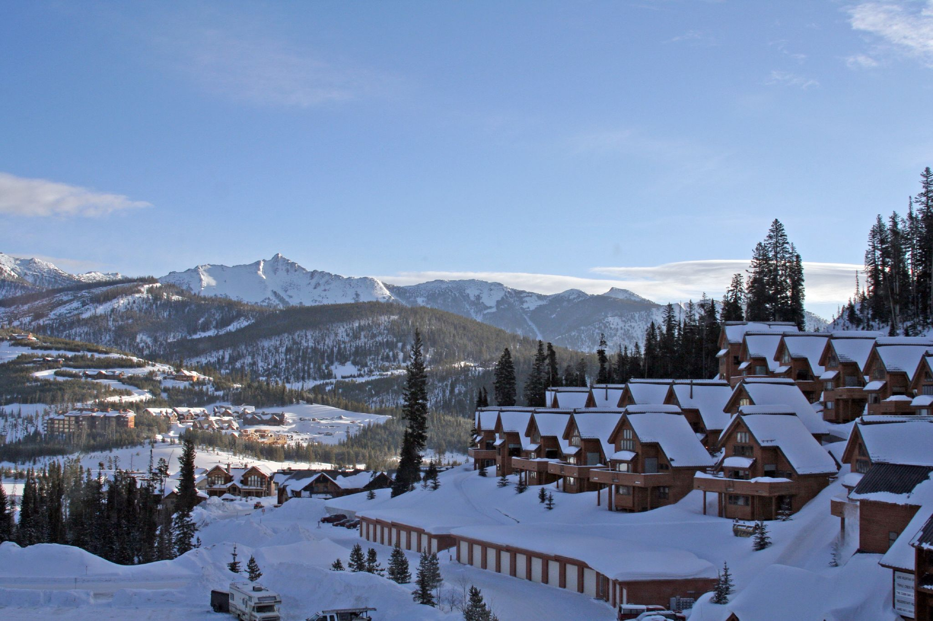
Big Sky Mountain
Revenue Increase

Slide 2
Problem Identification
In order to increase distribution of visitors, Big Mountain installed a new chair lift. Its operating costs are 1.54 million annually. Big Mountain needs to be able to cover these costs and continue to make profit.
Big Mountain Ski Resort needs to increase revenue by a minimum of 1.6 million with ticket sales by the end of the fiscal year in order to break even with operation of a new ski lift.

Slide 3
Recommendation: Increase Weekend Prices
Big Mountain Resort currently charges $81 for their weekend tickets. When using our predictive model based on other ski resorts in the US market we found that Big Mountain Resort’s modelled is placed at $95.87.

Slide 4
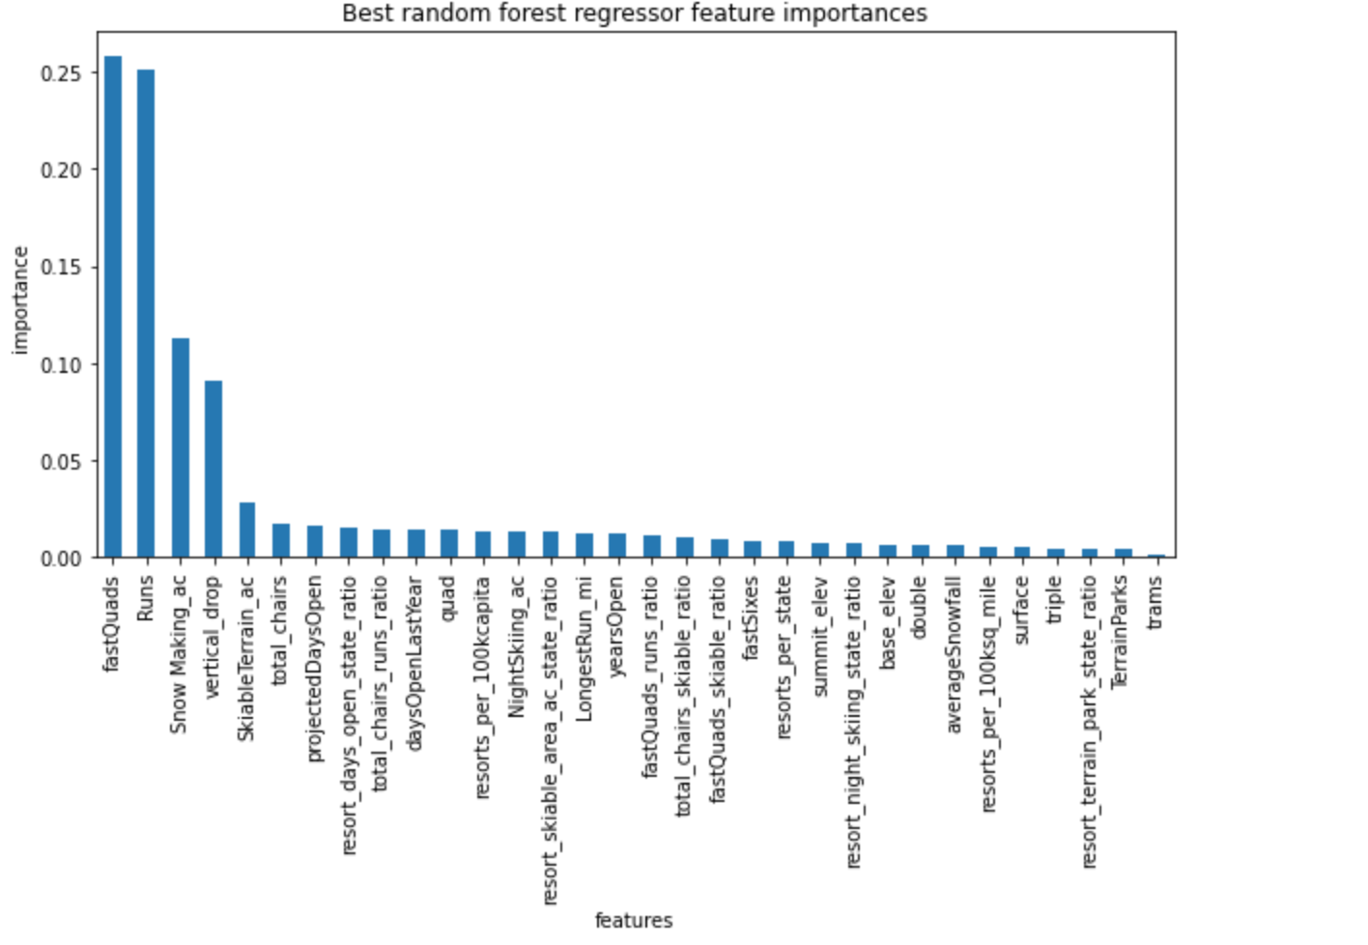
Big Sky offers an impressive array of features that correlate with higher ticket prices.

Slide 5
Impressive Facilities:
The following slides will compare Big Mountain’s Features to the rest of the market share

Slide 6
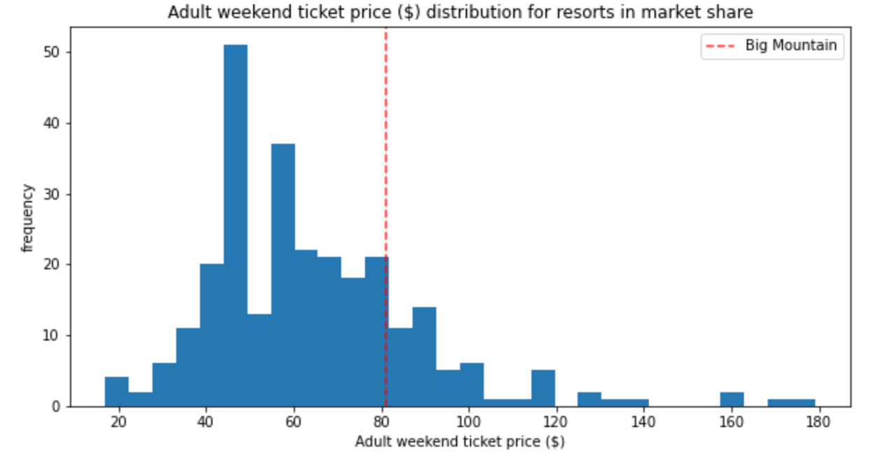

Slide 7
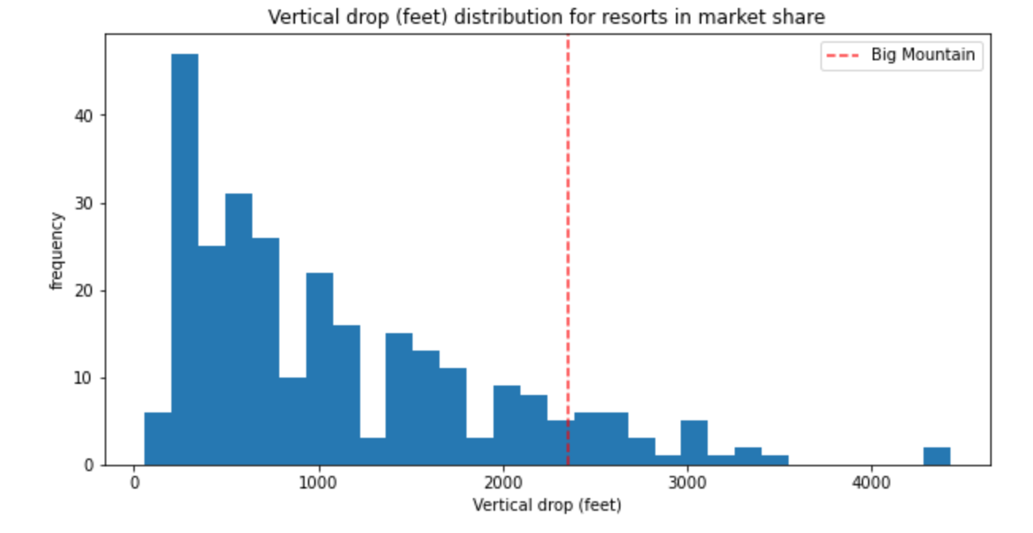

Slide 8
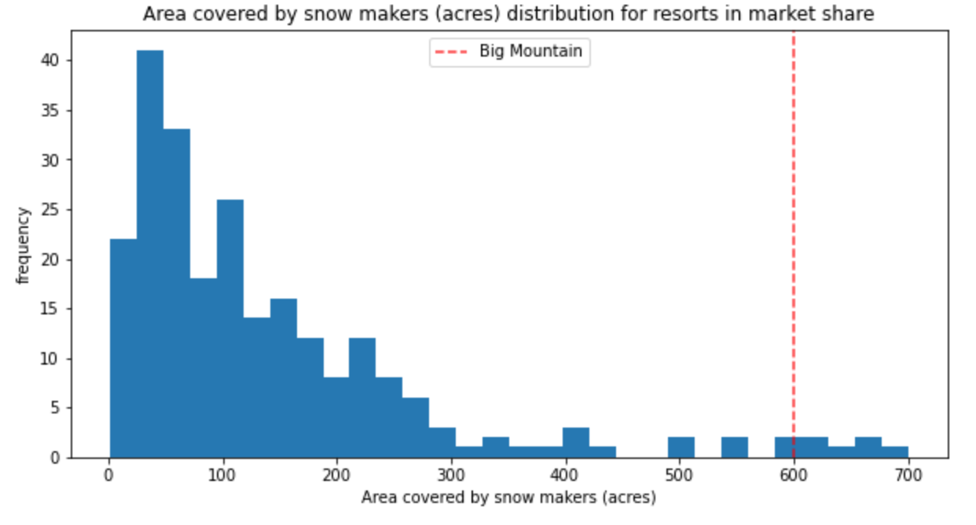

Slide 9
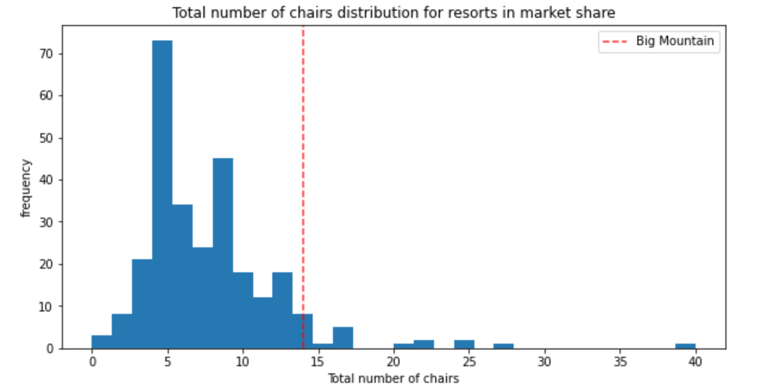

Slide 10
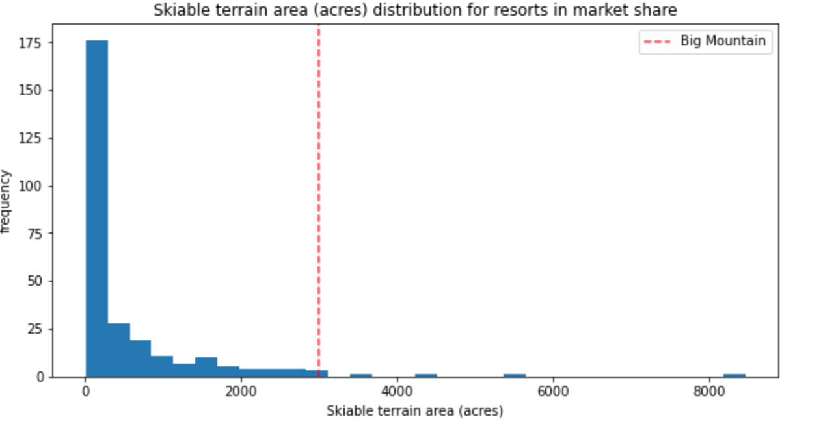

Slide 11
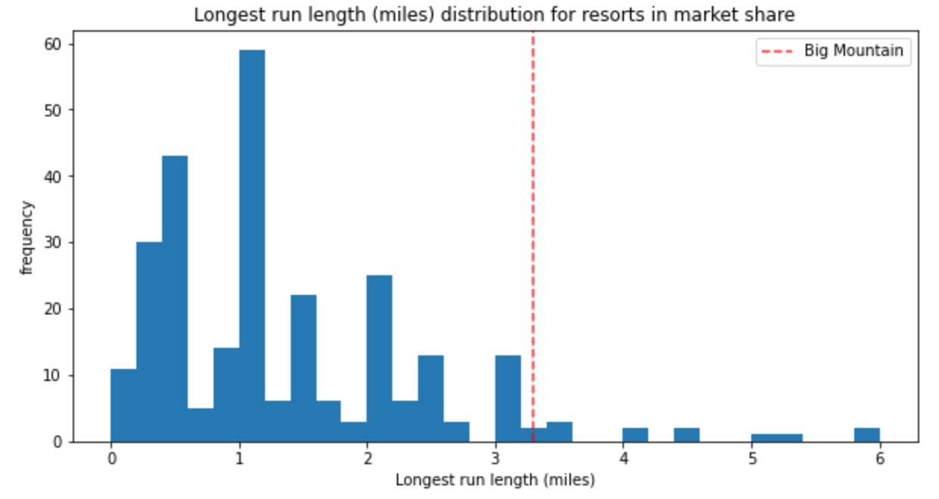

Slide 12
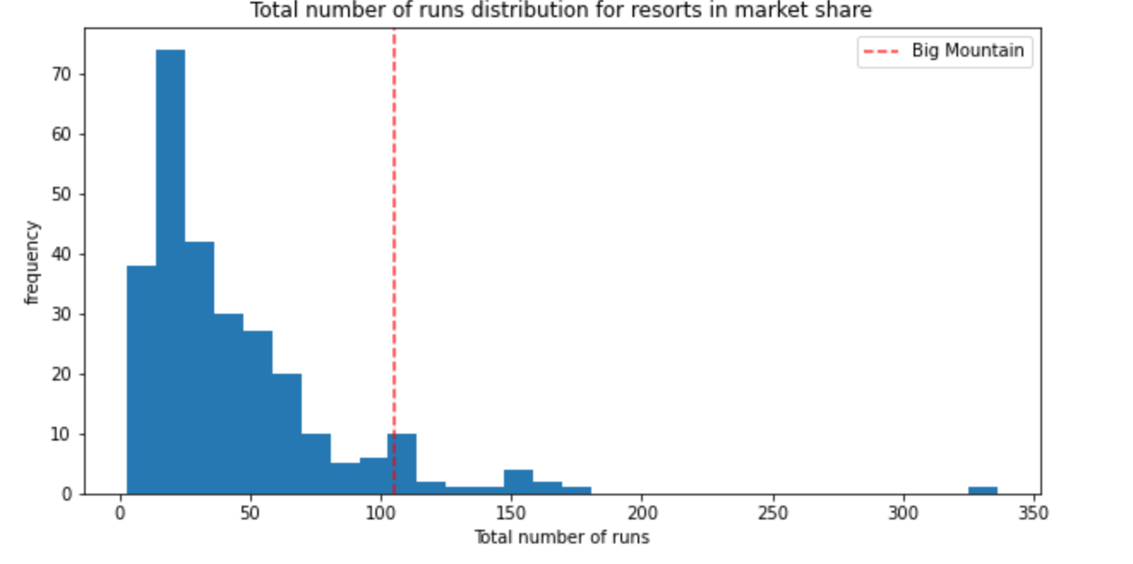

Slide 13
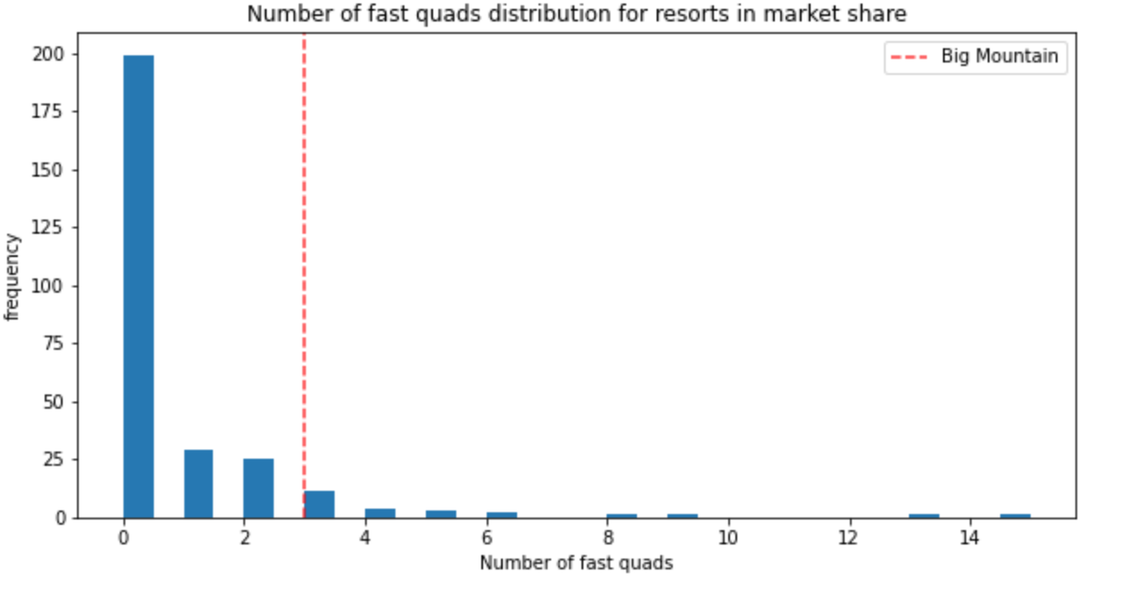

Slide 14
In conclusion
The predictive modelling gave Big Sky a higher price than previously used. The increase from $81.00 to $95.87 for weekend tickets can be justified by what Big Sky is offering compared to the rest of the market share. We can see by the previous graphs why the algorithm would suggest a higher ticket price. We also showed correlation between certain features (of which Big Sky has) and raised ticket prices.

